Slide 1

Securing Data Privacy
Group 6 : Shailesh, Wah Yang,
En Ming, Jesse,
Hanif, Khai Bhin
Notes:
Shailesh
Introduction:
Good morning everyone, my name is Shailesh of Group 6, and these are my groupmates:
[introduce groupmates]
Today I am accompanied by my group to give a presentation regarding the solution we have designed to combat the ethical issue of data privacy. In assignment 1, we researched several ethical issues that are involved with potential uses of AI. After careful deliberation, we agreed to use the issue of data privacy as the foundation for our solution. In today’s presentation, we will be going over a few key processes in designing the solution and we will also unveil our solution’s prototype.

Slide 2
Ethical Issue: Data Privacy
Definition
Respect Privacy
ACM Article 1.6: Individuals must be made aware of what information is being collected and how is is being utilized, and must give their permission before automated information collection can be established
Honor Confidentiality
Data privacy is the protection of private information from third party entities and the ability of individuals to choose which entities can access their private data
ACM Article 1.7: Computing professionals should protect the confidentiality of collected information barring cases where the data collected indicates a violation of law, regulations or ethical code of conduct
Notes:
Shailesh
Ethical Issue:
Let’s start with explaining our ethical issue, data privacy. What is data privacy? Data privacy is the choice each person has in managing access to their personal data. To paraphrase, corporations and the like cannot use your data without consent, or at least they aren’t supposed to. According to article 1.6 of the ACM code of ethics, individuals must be made aware of what information is being collected. However, most corporations are not transparent with the type and quantity of data they collect from individuals. For example, in 2016, the British consulting firm Cambridge Analytica was accused of secretly housing data on 50 million Facebook users without consent (Ma, 2019). Another article from the ACM code of ethics states that computing professionals should protect the confidentiality of collected information. Nevertheless, companies like Facebook and Google have been accused of illegally selling consumer data to third party corporations. The solution we plan to implement will rectify the ethical issues brought up.
Passing to 2nd speaker:
Now, I would like to pass the floor to Hanif to explain our solution.

Slide 3
Our Solution
Increase transparency
Whitelist and Blacklist
1
3
Track and log what data is being used, how it is being used, and when it is being sold.
Enable users to whitelist and blacklist organisations from collecting personal information.
Level of trustworthiness
Firewall
2
4
Determine the level of trustworthiness of organisations trying to collect data.
Detect, prevent, and report to user when an app or website is collecting data without consent.
Notes:
Hanif
Thank you Shailesh, I will now present to you our solution towards the issue surrounding data privacy and why it is effective.
In response to the data privacy issue caused by AI, we have collectively decided as a team to develop an application that aims to increase the level of transparency of which personal information is being collected, how it is being used to benefit the user and organization, and when it is being sold to other third party organizations. From here, the user can report an issue if sensitive personal information is being collected or if the data collection doesn’t benefit them.
Our application will also be able to determine the level of trustworthiness of the organisations trying to collect information. This will be based on three main points. First, the history of how they collect and handle user data. Second, how vulnerable their databases are to data breaches. Third, which other organisations they sell their data to and their reputation of handling user data. This rating will help users decide whether they should give consent and discourage organizations from blindly selling user data to third party organizations.
The third feature of our application is to whitelist and blacklist any organisations from collecting personal information. With this, the user can see which organisations are able to collect their personal information and prevent the need for apps and websites to always ask for permission whenever the user visits them. In conjunction with the other features, the user will be able to easily move organizations from their whitelist to their blacklist whenever they decide to discontinue any current data being accessed.
Finally, we will have a firewall system whose main purpose is to prevent websites from secretly collecting user data without the user’s consent.
I will now pass it to En Ming.

Slide 4
Work System Design for Data Privacy
Socio-Technical System
Features in our app
Natively, the most common languages are Malay and English
In terms of difficulty, iOS app development is easier than Android
Firewall which can detect, prevent and report when websites or app take data without consent
Dictionary of blacklist and whitelist websites, choice of selecting website to be blacklisted or whitelisted.
Use of ACM Code of Ethics and Professional Conduct
Operating System software compatible with the app is iOS 10 or later
Log Tab, Tracks which websites have taken what data (e.g. Browsing history, App history)
Choice to discontinue any data sharing and create new account
Implementation of Mobile application over Desktop application
Scoring system to show the safety of the website and a option of whether to notify when websites become risky
Average iOS app size is 31.4 MB
Data Privacy App
Notes:
Script for FIT 1055 Presentation
Thank you Hanif, now I will be presenting about work system design for data privacy. Firstly, work system design is split into 3 circles, the outer circle, inner circle and lastly the core circle.
We started with the core circle, where we needed to implement the “core system” which in this case will be a Data privacy application. After the core circle we will now move to the inner circle which we implemented the features we would want to include in our application.
So some of the features, we’ve decided to implement is a
Firewall which can detect, prevent and report when websites or a random app takes data without consent…
A Logs Tab, which can track which websites have taken what data (e.g. Browsing history)
Scoring system to show the safety of the website and a give a option of whether to notify when websites become risky
After the implementation of the inner circle, we will move on to the outer circle. This circle basically represents the socio-technical system which contains non-technical elements which influences how the system will be designed.
So for example, some of the non-technical elements we’ve included are
The implementation of native languages such as Malay and English. This is because the culture of an app in a certain country can impact sales heavily. Next is
the use of ACM code of ethics which is a policy that is required when creating the system in computer science. For the next non-technical element it will be the
implementation of Mobile application over Desktop application users. This is because Mobile users are more significant then desktop users roughly about 36% more, therefore the choice of mobile implementation will influence how the system will be designed to cater for the mobile platform (Enge, 2021).
The next non-technical element is the choice of operating system, normally iOS app development is easier than android therefore choosing iOS app over Android will be better when designing the system.
Another non-technical element is the operating system software compatibility. The more compatible the app is to older software version, the larger the user base will be. However, this will influence on what options our system can be designed since options may be limited to the software version compatibility which in this case is iOS 10 or later
The last technical element is the average size of an iOS app. This size will be a guideline on how many features and animations we can apply to our app before the app size becomes too large.
That’s all from me, now I’ll be passing the presentation to Jesse where he will present on ethical coding.

Slide 5
Ethical Coding
The application will run at its full potential regardless of paid users and free try users(until their time runs out).(ACM1.4)
The application checks each website without biasness regardless of what kind of website it is. (ACM 1.4)
Zoom in/out and narrator features to help users with short-sightedness and vision disabilities.(ACM 1.4)
Features that are used encrypts data that is given to approved websites and can be used by everyone regardless of race and region.(ACM1.4)
The data detected and collected by our application will not be used for any other purposes except for running the application (ACM 1.6)
The collected history data of users will be honoured confidentially and entrusted only to computing professionals working on this section. (ACM 1.7)
The application design and coding follows all computer related rules of our country (ACM 2.3)
ACM 1.4 Be fair and take action not to discriminate.
ACM 1.6 Respect privacy.
ACM 1.7 Honor confidentiality.
ACM 2.3 Know and respect existing rules pertaining to professional work.
ACM Code of Ethics and Professional Conduct. (n.d)
Notes:
Thanks En Ming,Ethical coding means an organization’s ethical guidelines and best practices to follow for honesty, integrity and professionalism. Ethical codes are adopted by organization to assist members in understanding the difference between right and wrong and in applying that understanding to their decisions.
we will following ACM (Association for Computing Machinery) code of ethics and professional conduct, then read out ACM script
1. Our app gives the same amount of efficiency to free paid user and paid user
2. Our app does not block websites with biasness, it only protect users personal information
3. We understand there are certain people with disabilities that we have to help them overcome. By having these features, zoom in/out u don’t hv to squint ur eyes or u cld just listen to the narrator.
4. Our features that we use for app does not discriminate, anyone can use our app regardless of who you are and where u come from
5. As a data privacy app, we wld def not be using anyone’s data that we hv collected, in this case most of the data will be encrypted so only the professionals wld know and keep ur data in a safe place.
6. In this case we wld not intrude into anyones privacy, we respect all our users privacy and honour their confidentially
7. Lastly, we hv to abide rules which we will follow closely. Like we hv to maintain a high-level integrity of our company.
Thats all for my part I will pass the time to Khai Bin

Slide 6
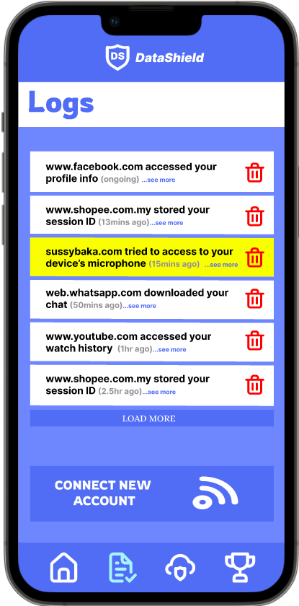
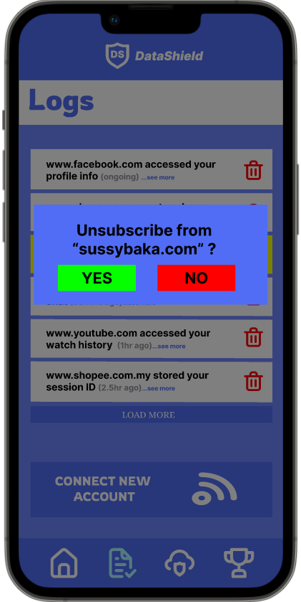
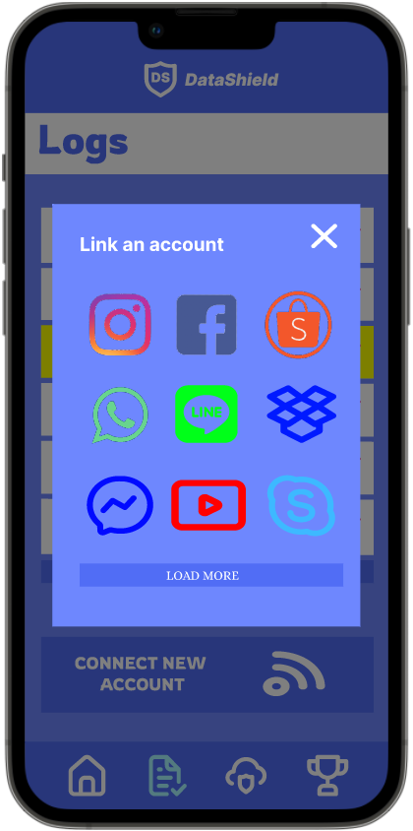
Prototype Demonstration: Log
Overlay will pop up that enables
user to link to an account
which then the app will monitor
the dataflow of the app
Asks user’s confirmation to
unsubscribe chosen website/service
Clicking on the
trash icon will
prompt
Clicking on connect
new account will
trigger
Logs that show
website/service that
accessed to your data
Notes:
Thanks Jesse, Moving on to the prototype, We have created a prototype in order to demonstrate how the application would work. First off, the log feature as shown here show websites and services that have accessed user’s data. For example, facebook, which currently is accessing user’s profile information. As you can see, there are red trash icons beside each log, indicating delete. Upon user’s command, clicking on the icon will prompt user and asks for user’s confirmation to unsubscribe the chosen website or service. Moreover, there is a connect new account button as shown here, clicking on it will trigger an overlay to pop up which enables user to link to an account which then the app will monitor the dataflow from and to the app. Next up, I’ll talk about the next feature.

Slide 7
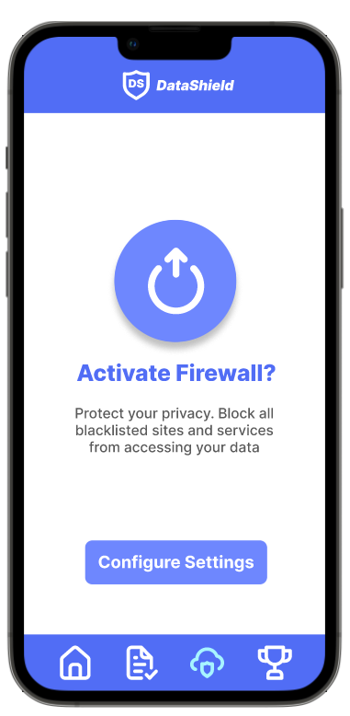
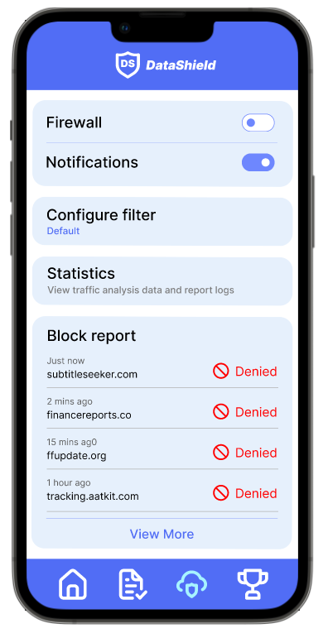

Prototype Demonstration: Firewall Feature
Firewall feature that detects and prevents websites and services from attempting to collect your data without your consent
Configure filter to customize how the firewall protects your data and under what conditions should the firewall block the connection
Fun Fact:
32% of the population
worldwide uses desktop
to visit websites while
the other 68% uses mobiles
And tablets (Enge, 2021)
Generate a block report for user to view
Notes:
Now this feature is a firewall feature, When users activate the firewall in the app, it will start to detect and prevent websites and services from attempting to collect and use users data without their consent. When users click on configure settings, the right picture will show up. Users then can configure filter to customize how the firewall protects their data and under what circumstances the websites or services should be blocked. Furthermore, there is a block report section generated to show users what website or apps which has been denied access when trying to access user’s data. That’s all from me, I will now pass the stage to Wah Yang, who will talk about the rest of the feature.

Slide 8
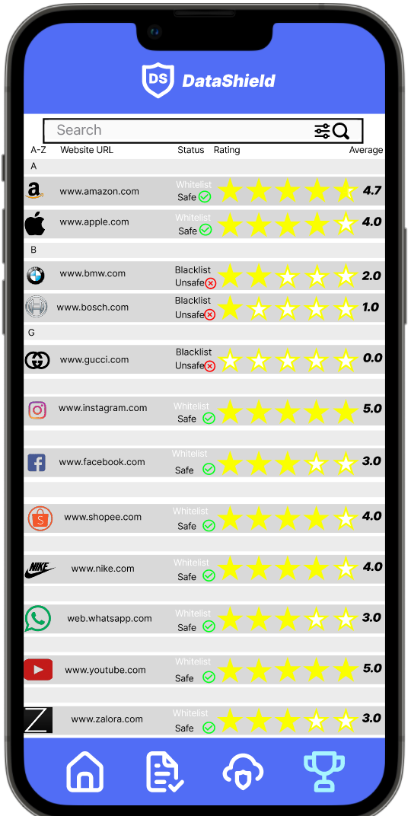
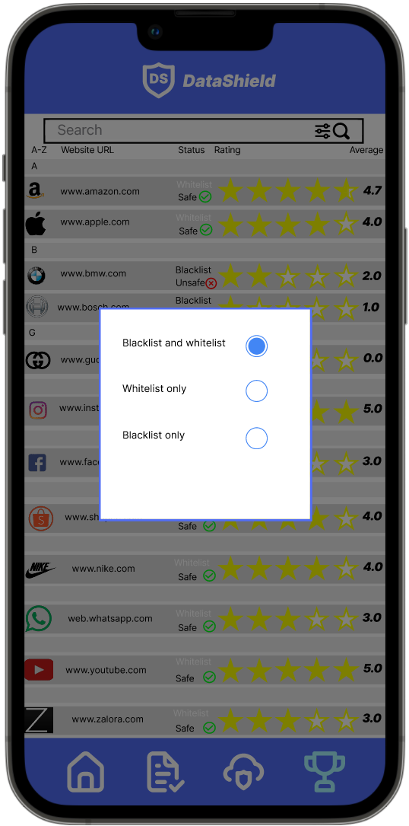
Prototype Demonstration:
Website dictionary
Pic 1 Pic 2
Pic 1
- All recorded websites
filter button
Pic 2
-overlay
(showing three options)
Website bar
Pic 3 (next slide)
Notes:
Thanks Khai Bin
The next feature is called the website dictionary, it contains all the websites recorded by the app. All the websites are stored alphabetically there is a search bar above to find for particular website. Besides of showing the websites name it also shows the status on whether it is on blacklist or whitelist as well as their average scores.
On the search bar there is a filter button pointed by the arrow at Pic 1 , when you clicks on it, an overlay will appear as shown in pic 2 and users are able to choose to show only blacklisted websites or whitelisted or both.
Next, click on the website bar and it will take you to pic 3

Slide 9
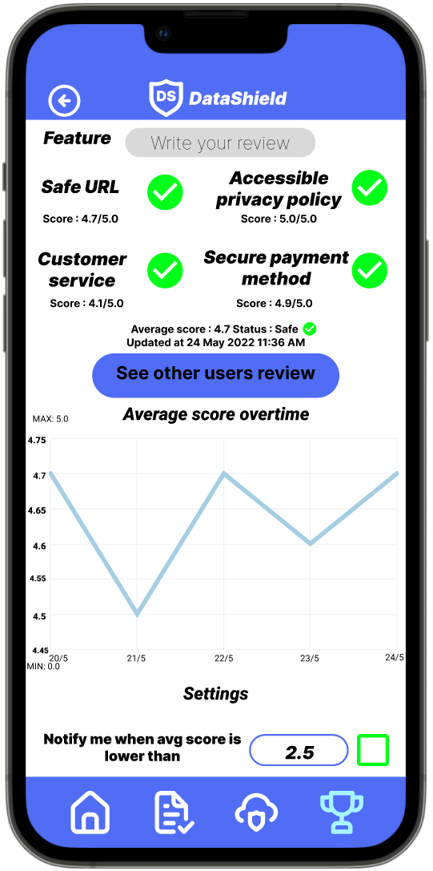
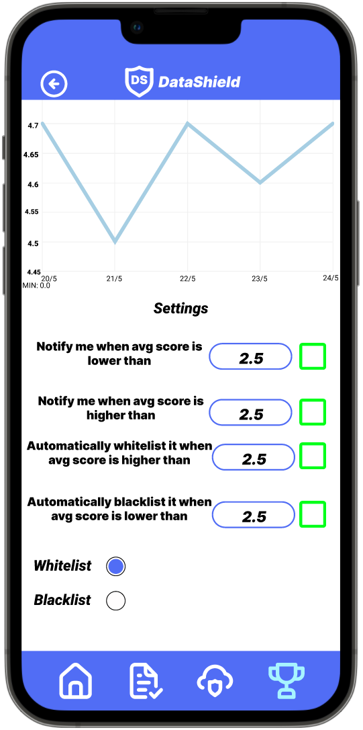
Pic 3 Pic 4
Pic 3
-all the safety feature of the website
-calculated average score
-graph on history of the avg score.
Pic 4
All settings
-green box to tick
-blue box to fill in your value
-blacklist and whitelist button
Notes:
So in Pic 3 First it will show all safety feature of that website, for example how good is their website feature. In here public cooperation is also needed in order to provide enough numbers of honest reviews. App users can also add their own review by clicking the “Write your review” button. Below pic 3 is a line graph about history of the average score.
Scroll to the bottom will take you to Pic 4. Pic 4 contains all the setting related to that particular website. Here user can choose the setting for example they wanted to be notified when some website has average score lower or higher than the value in the blue box and even automatically blacklist it or whitelist it. The last part is the whitelist and blacklist button. That’s all for the prototype.
Now I will pass the floor to the next speaker
Thank you

Slide 10


Slide 11
Conclusion
01
02
03
04
Problem
Solution
Methodology
Reflection
The ethical issue we discovered
The solution we proposed
How work system design and ethical coding impacted our implementation
What did we gain from this process
Notes:
Shailesh
Conclusion:
Thanks Wah Yang
To summarize, we wanted to solve the problem of data privacy. The solution was intended to enforce and protect the privacy of user, so they do not fall victim to the exploitation of their data. Therefore, we designed a prototype implementation that encompassed the features previously stated to allow users to control access to their data.
Reflection:
Throughout the course of the assignment, we strived to apply what we have learned this past semester. We used the ethical reasoning framework to recognize ethical issues and guide solution design, we utilized ethical coding in the design of UI elements and coding algorithms and we implemented the work system design concept when creating the prototype. Thank you everyone, that is all from us. Are there any questions?

Slide 12
References
Ma, A. (2019, August 23). Facebook understood how dangerous the trump-linked data firm Cambridge Analytica could be much earlier than it previously said. here's everything that's happened up until now. Retrieved May 8, 2022, from https://www.businessinsider.com/cambridge-analytica-a-guide-to-the-trump-linked-data-firm-that-harvested-50-million-facebook-profiles-2018-3#what-did-cambridge-analytica-do-1
What is data privacy? (n.d.). Retrieved May 12, 2022, from https://www.cloudflare.com/learning/privacy/what-is-data-privacy/
Enge, E. (2021). Mobile vs. Desktop Usage in 2020. Retrieved from https://www.perficient.com/insights/research-hub/mobile-vs-desktop-usage#:~:text=Globally%2C%2068.1%25%20of%20all%20website,total%20time%20on%20site%20globally
ACM Code of Ethics and Professional Conduct. (n.d). Retrieved from https://www.acm.org/code-of-ethics

